Slide 1
welcome

Slide 2
Estimation of business expenses

Slide 3
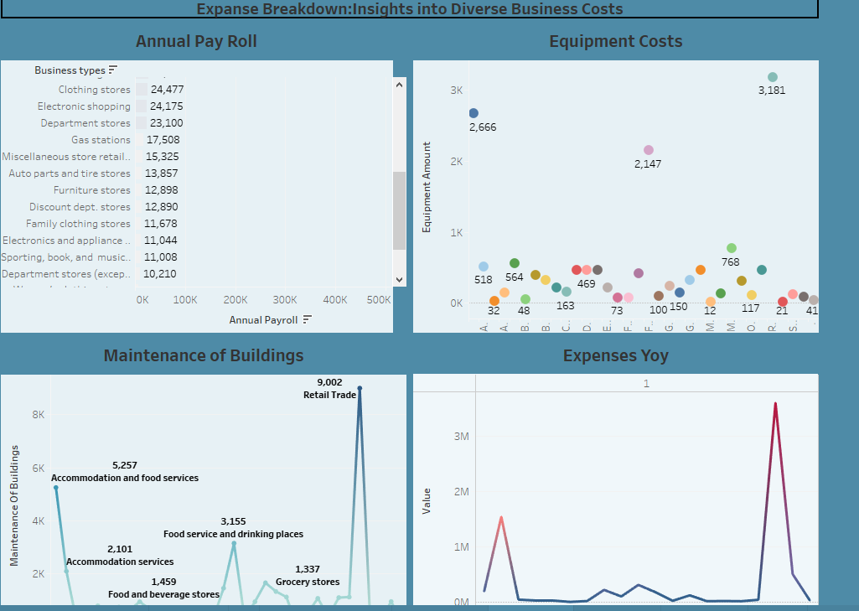
Expanse breakdown :into business costs

Slide 4
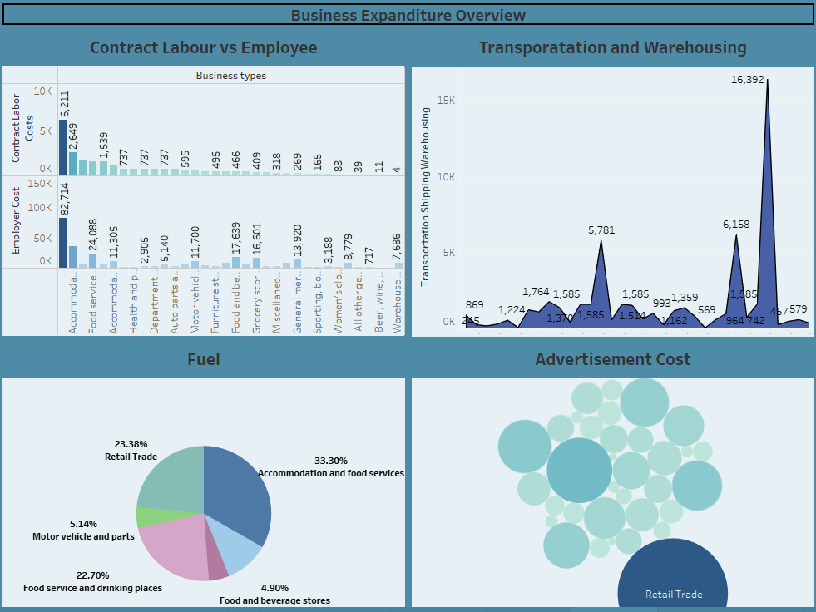
Business expenditure overview

Slide 5
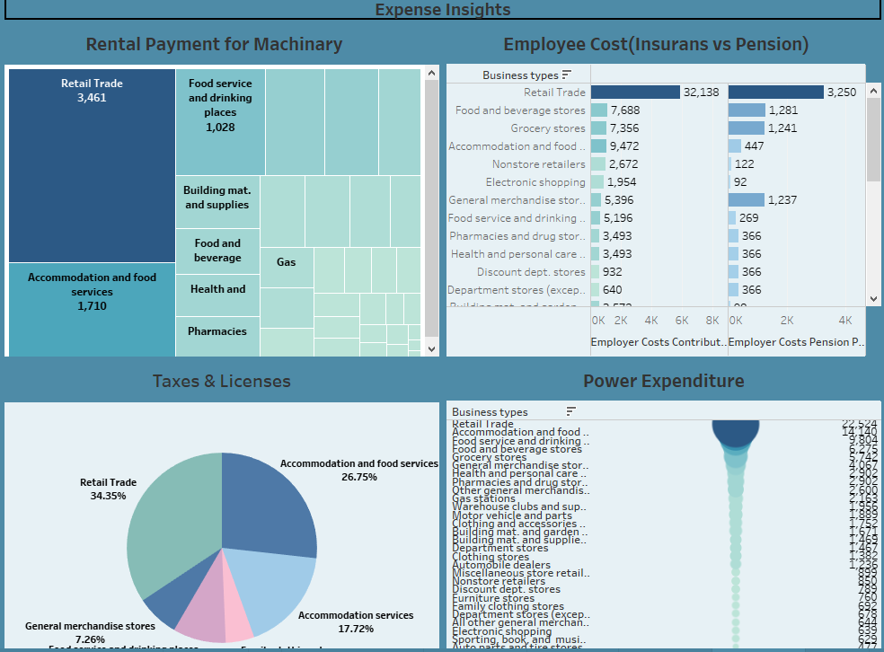
Expense insights

Slide 6
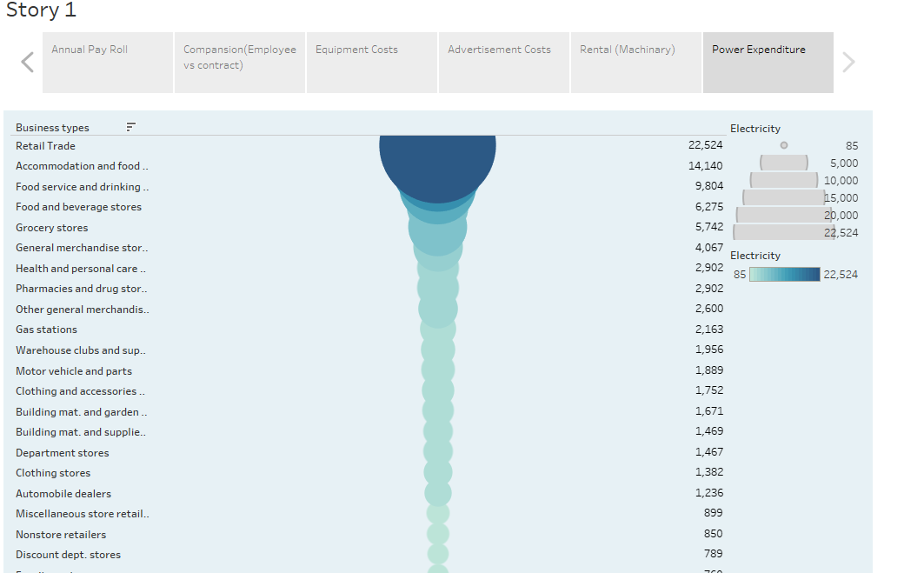
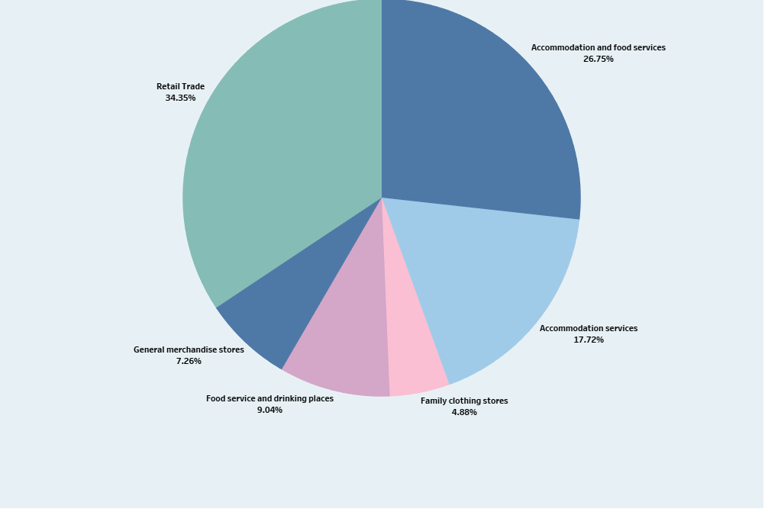
story

Slide 7
Thank you

